Slide 1
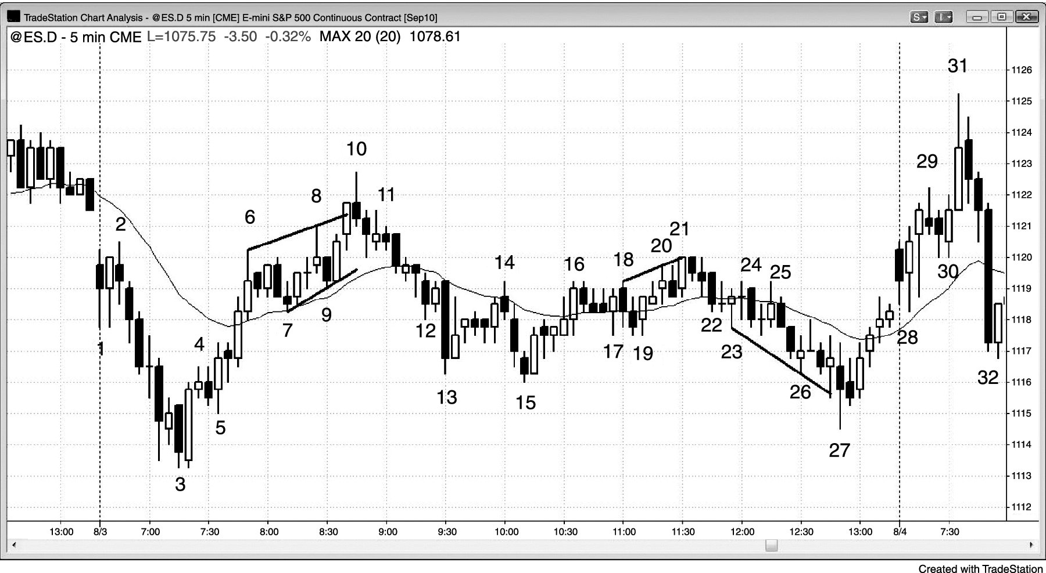
FIGURE 21.1 Three Pushes in a Spike and Channel

Slide 2
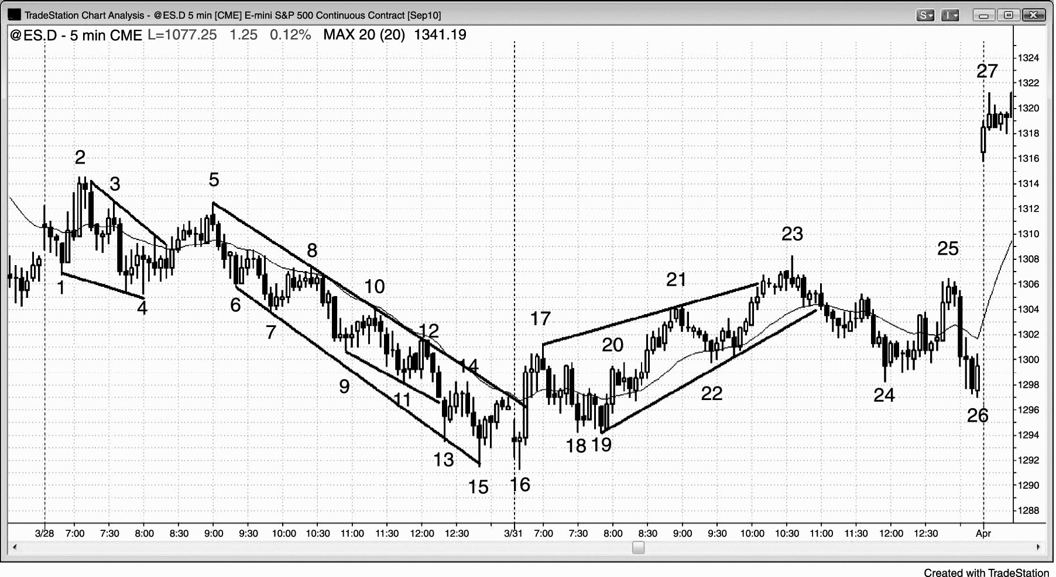
FIGURE 21.2 Spike and Channels Occur Every Day

Slide 3
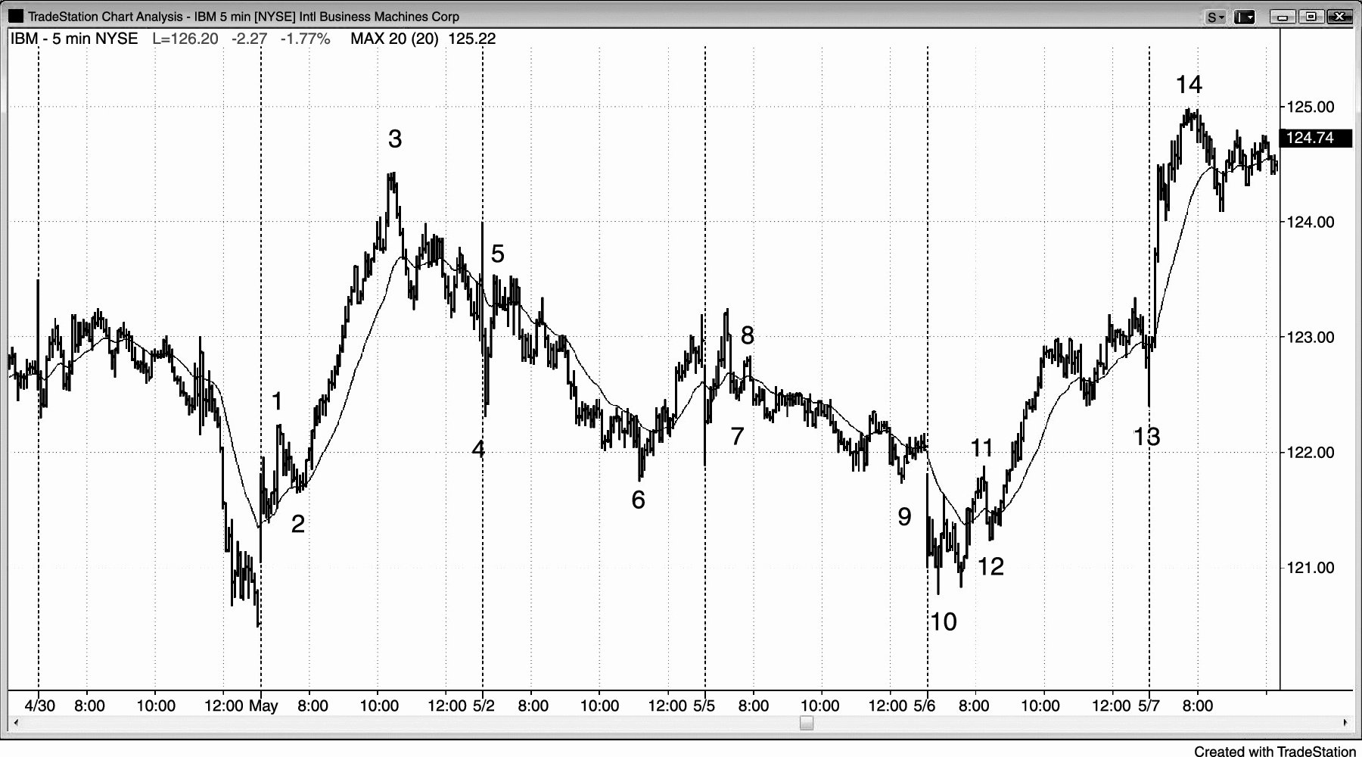
FIGURE 21.3 Spike and Channel Trends Are Common

Slide 4
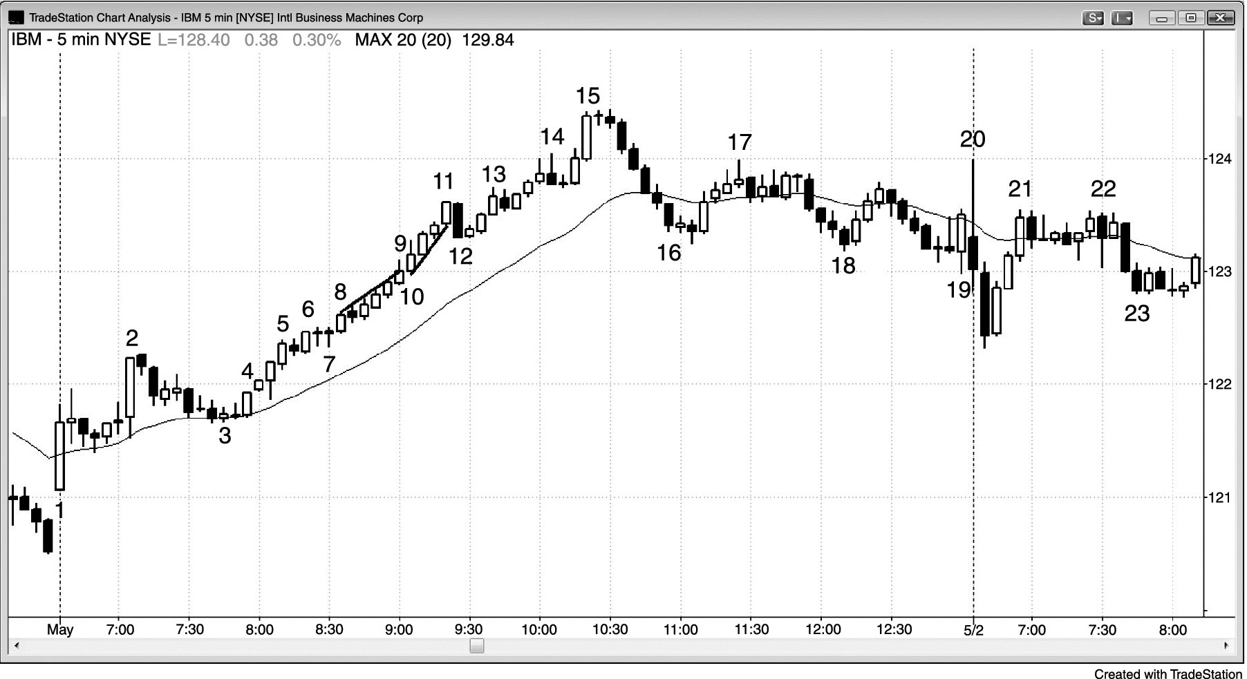
FIGURE 21.4 Steep, Parabolic Micro Channel

Slide 5
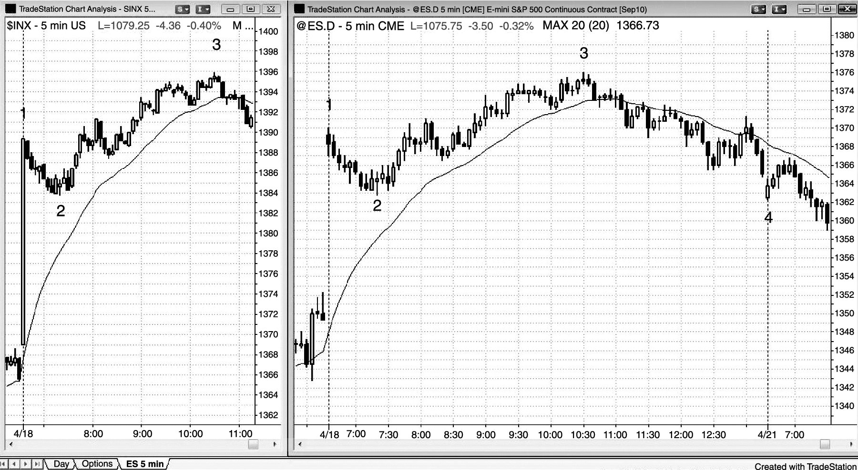
FIGURE 21.5 A Gap Spike and Channel Day

Slide 6
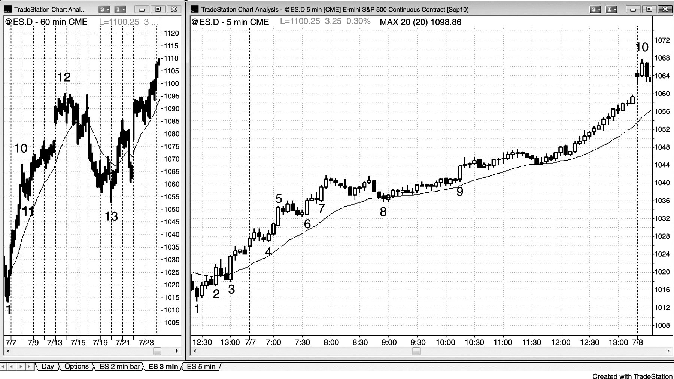
FIGURE 21.6 Steep Channels Are Spikes

Slide 7
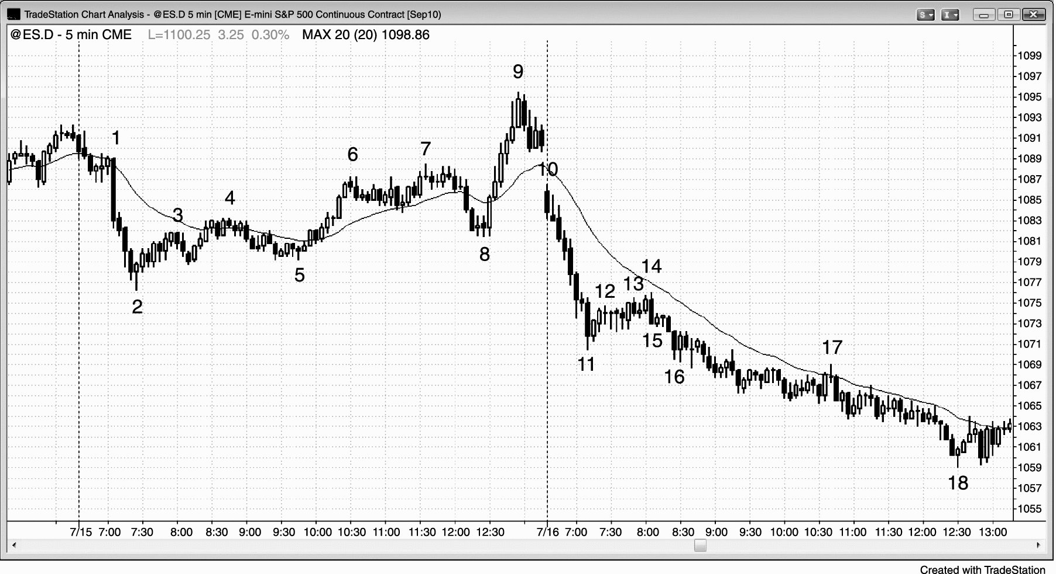
FIGURE 21.7 A Channel Can Follow Long after the Spike

Slide 8
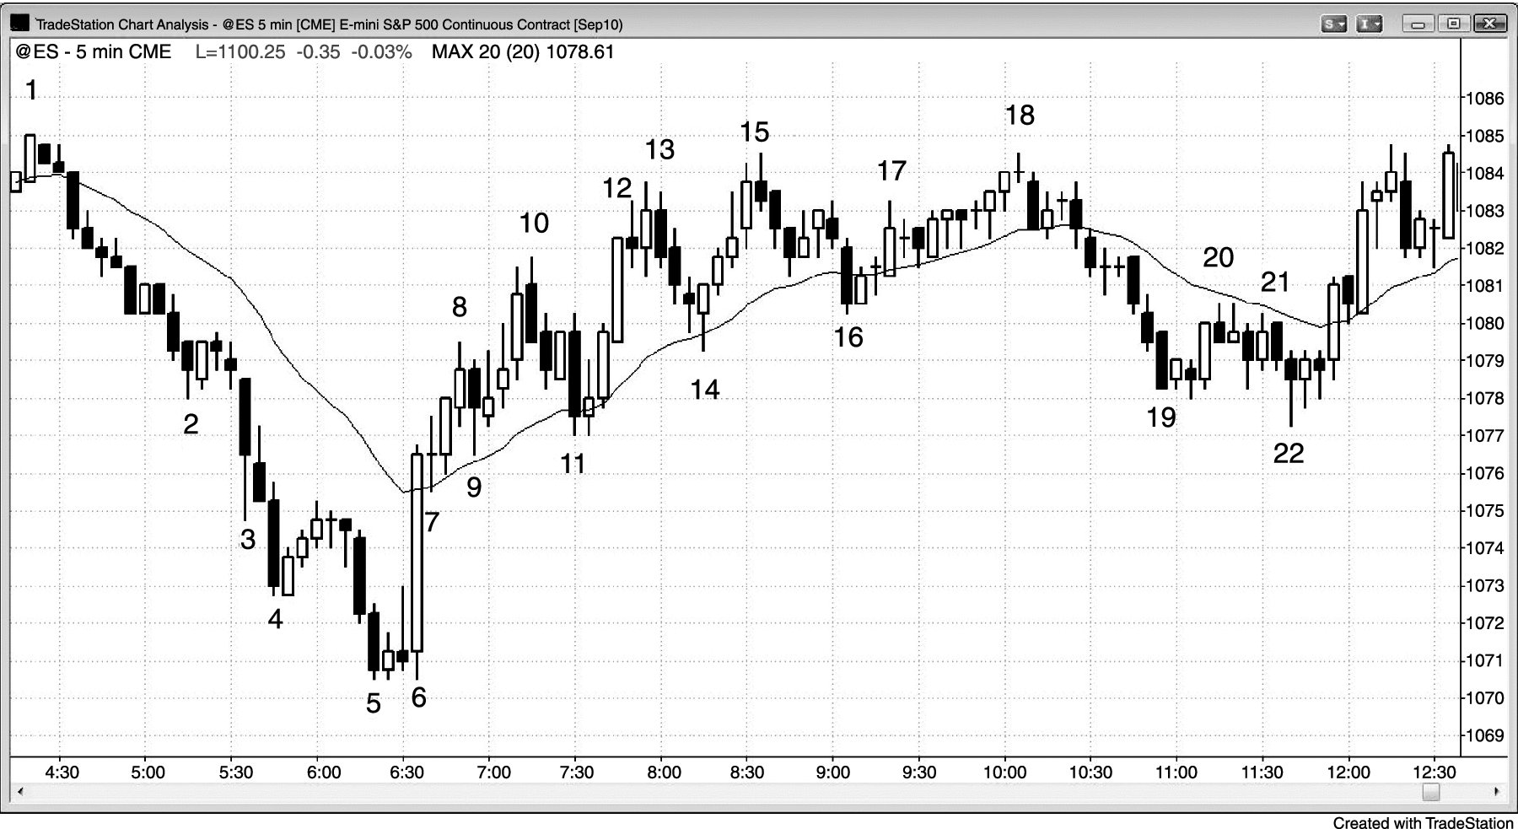
FIGURE 21.8 Consecutive Climaxes

Slide 9
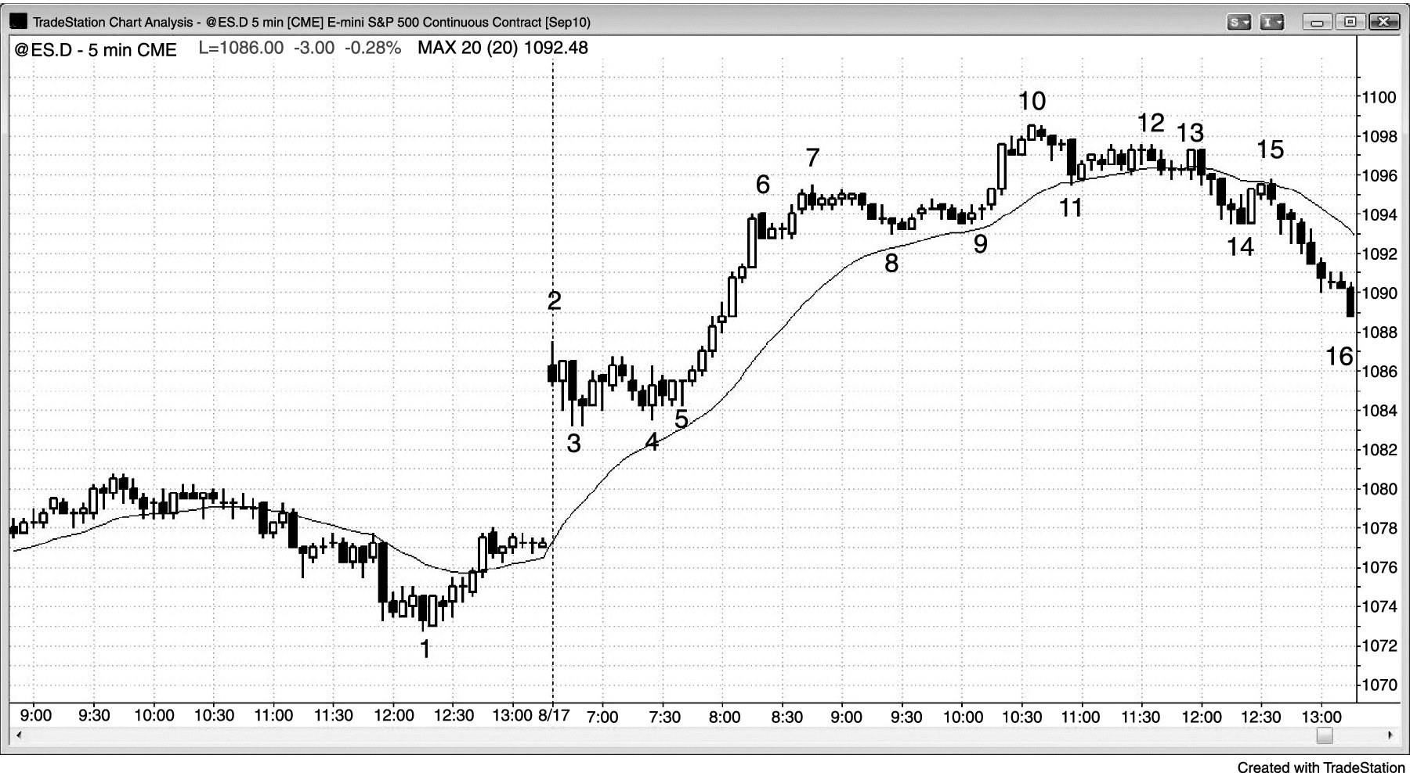
FIGURE 21.9 A Gap Up and Double Bottom

Slide 10
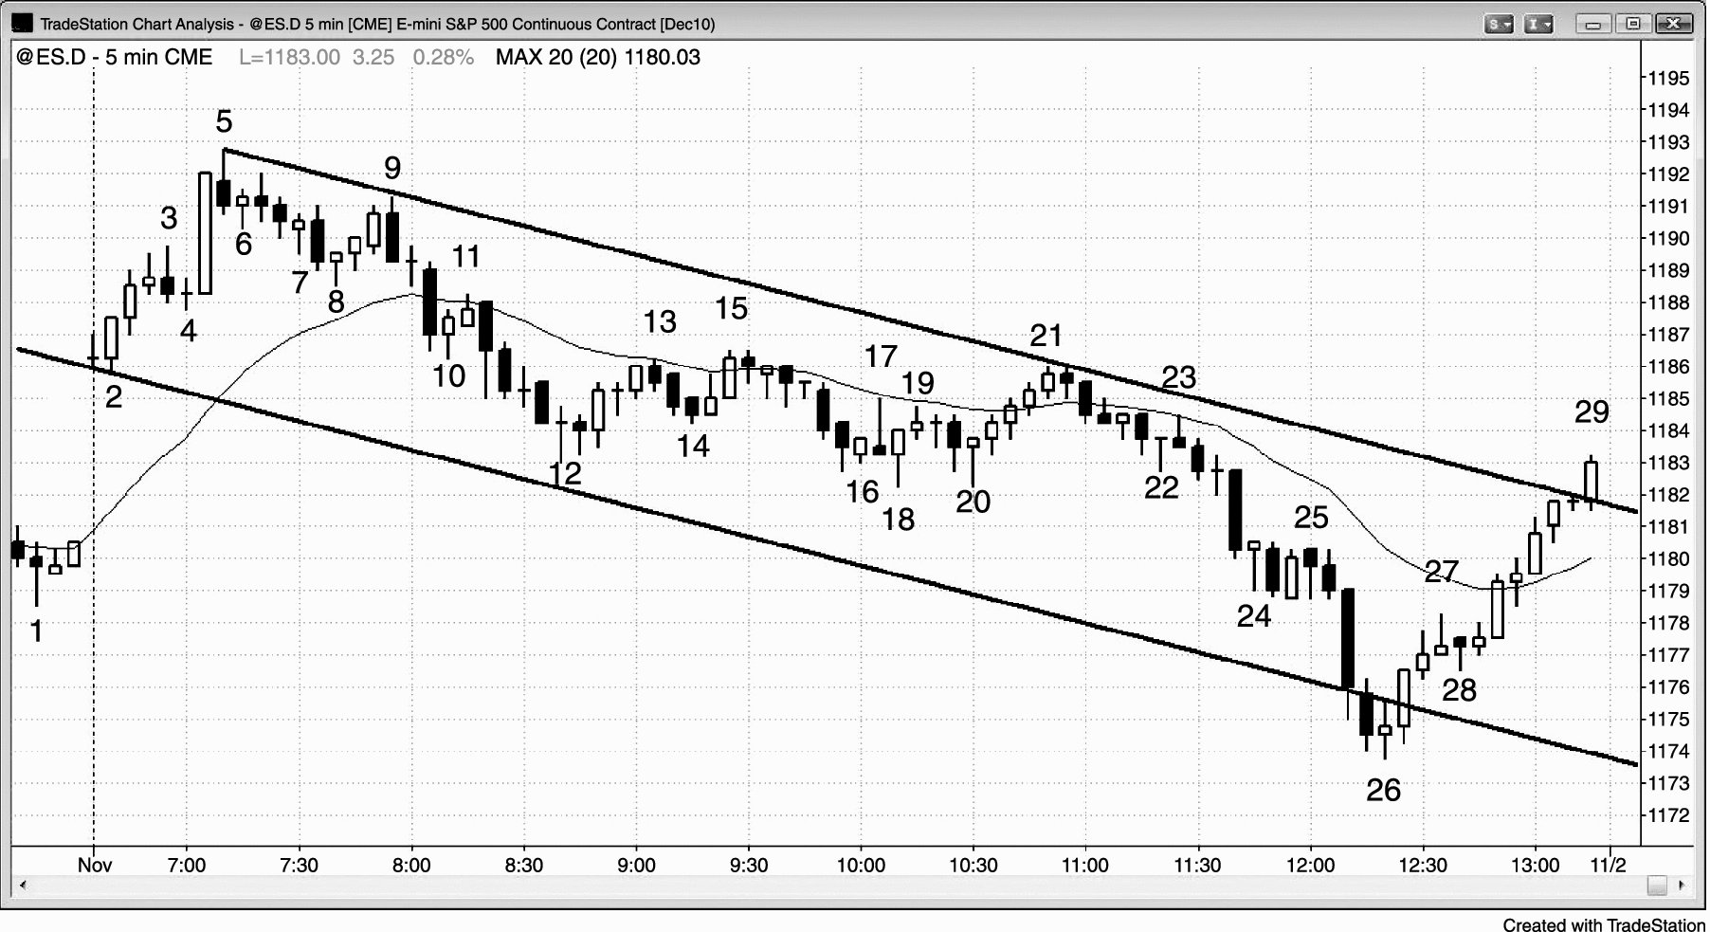
FIGURE 21.10 Spike and Climax

